Slide 1
Information Security Risk Analysis Risk Management
Gerhard Steinke

Slide 2
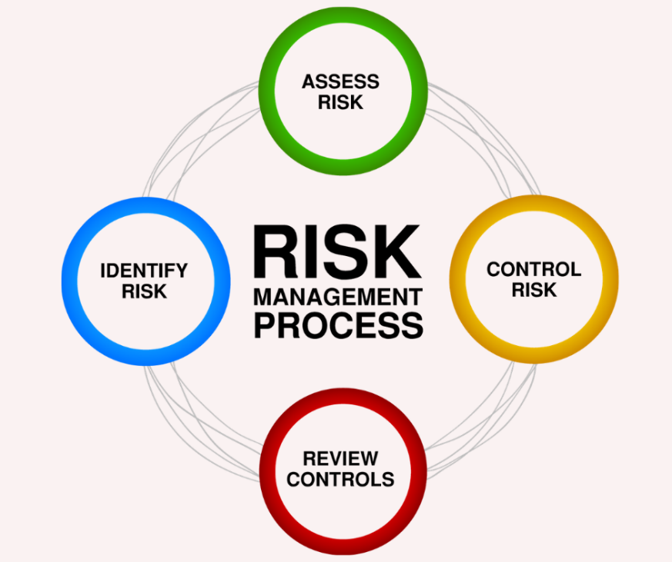
Risk Management Defined
Risk management is the identification, evaluation, and prioritization of risks followed by coordinated and economical application of resources to minimize, monitor, and control the probability or impact of unfortunate events or to maximize the realization of opportunities
Source: Wikipedia

Slide 3
Cybersecurity Risk Management Mission
To provide measurable and actionable risk intelligence through the identification, aggregation, and correlation of cybersecurity risk throughout the organization.

Slide 4
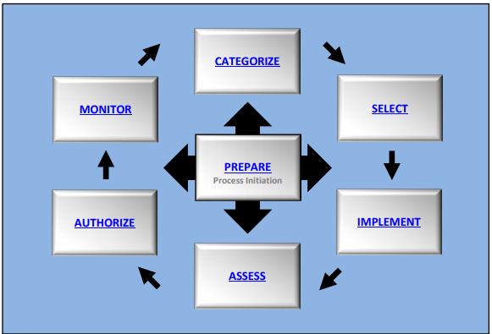
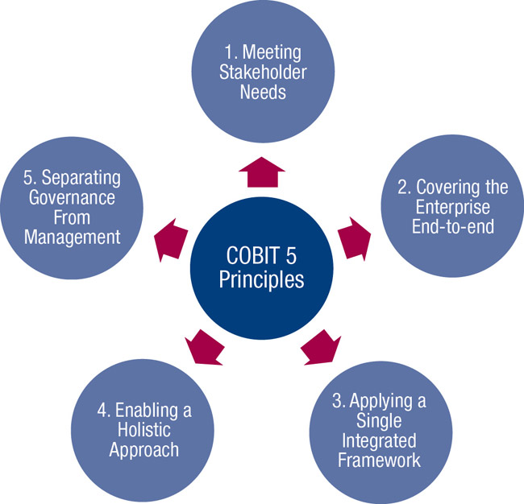
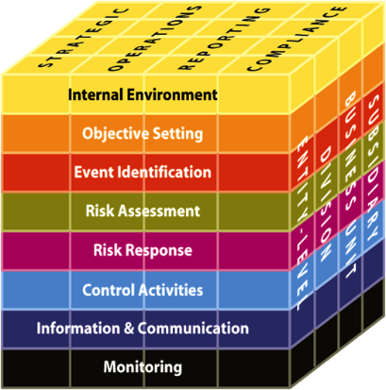
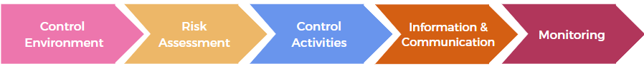
Examples of Risk Management Frameworks
NIST SP 800-37 R2 - CSRC
https://nvlpubs.nist.gov/nistpubs/SpecialPublications/NIST.SP.800-37r2.pdf COBIT - ISACA
COSO – The IIA
https://www.techtarget.com/searchcio/definition/COSO-Framework
https://www.isaca.org/resources/cobit
Notes:
Computer Security Resource Center
The 'Committee of Sponsoring Organizations of the Treadway Commission' ('COSO') is a joint initiative to combat corporate fraud. ... COSO has established a common internal control model against which companies and organizations can evaluate their control systems.
Information Systems Audit and Control Association, although ISACA now goes by its acronym only

Slide 5
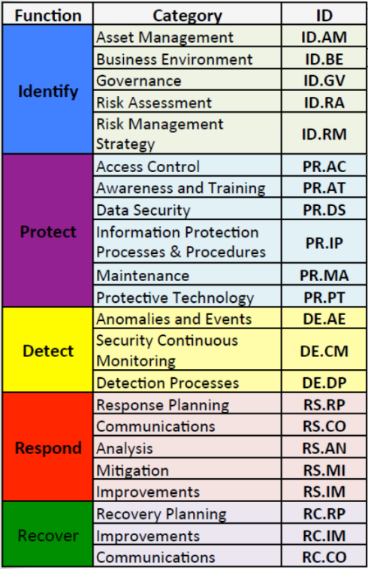
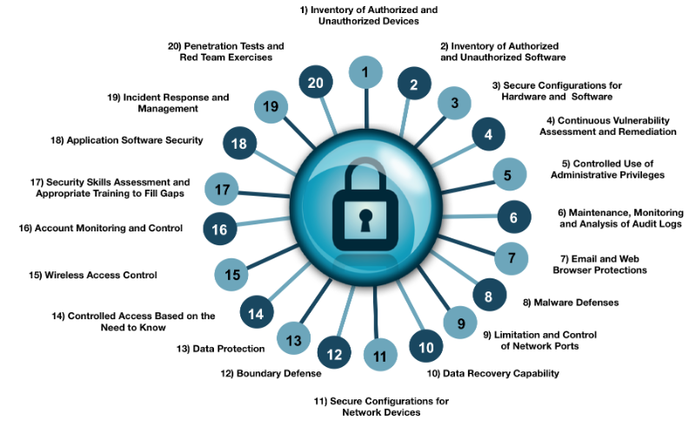
Examples of Security Control Frameworks
NIST SP 800-53 R5
Security and Privacy Controls for Information Systems and Organizations
Notes:
Other control frameworks – ISO/IEC 270001

Slide 6

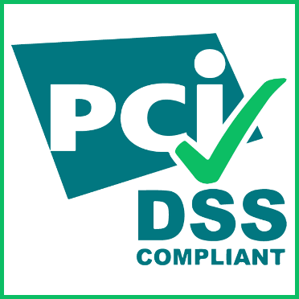




Specific Compliance Frameworks
Notes:
The Gramm-Leach-Bliley Act (GLB Act or GLBA) is also known as the Financial Modernization Act of 1999.

Slide 7
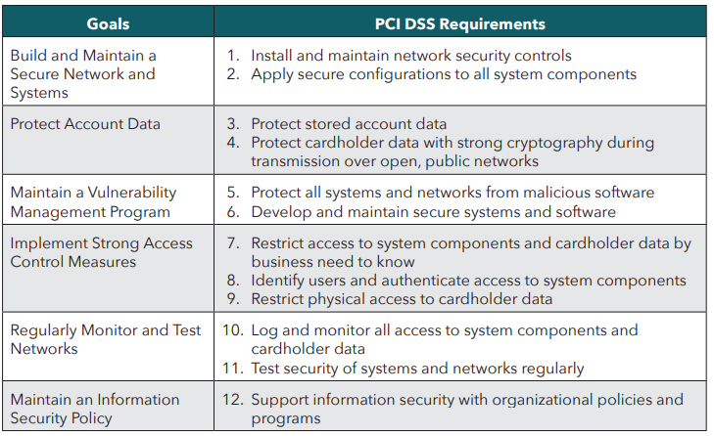
PCI/DSS Requirements https://www.pcisecuritystandards.org/

Slide 8
Sarbanes-Oxley act
“Organizations must include company's own assessment of internal control over financial reporting, and an auditor's attestation.”
Notes:
Also known as "Public Company Accounting Reform and Investor Protection Act"
Act of 2002. Section 404a – very broad –

Slide 9
Health Insurance Portability and Accountability Act (HIPAA) https://www.cdc.gov/phlp/publications/topic/hipaa.html
Privacy
Security
Breach Notification
Compliance & Enforcement
Special Topics
Covered Entities & Business

Slide 10
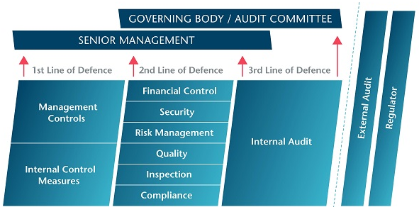
Three lines-of-defense
Source: The Institution of Internal Auditors (IIA)
Notes:
the first line of defense – functions that own and manage risk
the second line of defense – functions that oversee or specialize in risk management, compliance
the third line of defense – functions that provide independent assurance, above all internal audit.

Slide 11
Risk Management
Risk Analysis
Information Valuation
Threats
Vulnerabilities
Controls, Countermeasures
Risk Management Reports
Security Audits
11
Notes:
11
1
Prof. Lance J. Hoffman, The George Washington University
Risk analysis

Slide 12
Security Risks
Business/Strategic
Risks that impact the mission/brand/image of the organization – very large, sometimes difficult to quantify.
Financial
Risks that cause a measurable financial impact.
Operational
Risks that impact productivity and carry an opportunity cost.
Risk that information and information systems are compromised
12

Slide 13
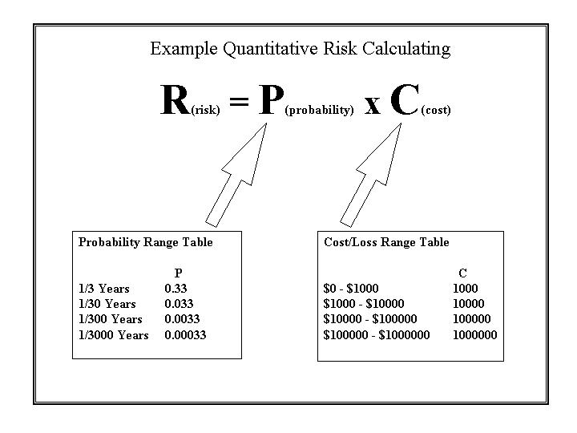
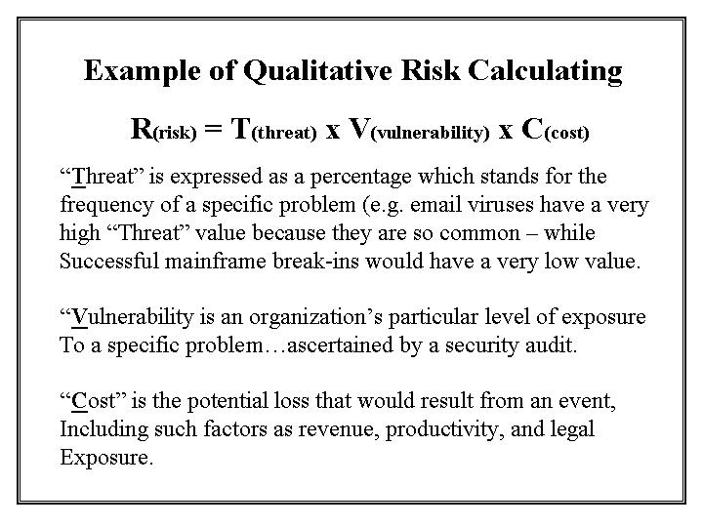
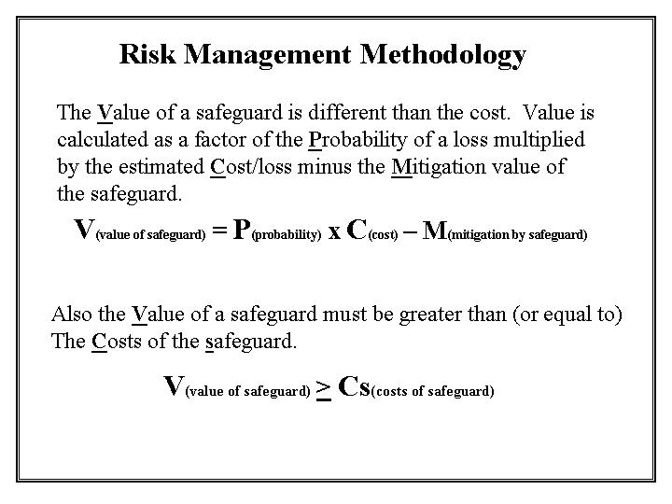
VULNERABILITIES + THREATS = RISK
13
Notes:
13

Slide 14
Risk Analysis
Risk assessment
valuation of assets
determining what the risks are
Risk management
defining controls, threats and vulnerabilities
evaluating alternatives for mitigating the risk
determining ROI
implementing risk reduction measures
14

Slide 15
Definitions
Asset
Any function, task, capability, equipment or information that has value to the organization or supports the ability of the organization to conduct business
Threat
Any person, circumstance or event that has the potential to cause damage to an organizational asset or business function
15

Slide 16
Vulnerability
Any flaw in the design, implementation or administration of a system that provides a mechanism for a threat to exploit the weakness of a system or process
Countermeasure / Control
Any process, procedure, product, feature or function that will restrict/block access, deter, or lower the occurrence of a threat/vulnerability within the specified environment
Something that reduces the risk
16

Slide 17
Definitions
Risk
Loss potential that a threat will exploit a vulnerability
The likelihood that something unwanted will happen - probability
Risk = Loss ($) X Probability
Risk = Threat * consequence * likelihood
Exposure
An instance of being exposed to losses from a threat
17

Slide 18
Single loss expectancy (SLE) =
Asset value * exposure factor
Annualized loss expectancy (ALE) =
SLE* annualized rate of occurrence
Exposure factor =
Percentage of asset loss caused by identified threat
Annualized rate of occurrence =
Estimated frequency a threat will occur within a year
18

Slide 19
19

Slide 20
20

Slide 21
21

Slide 22
Risk Assessment
Identify assets
Determine valuation of assets
Identify threats / Assess vulnerabilities
Foreseeable risks and vulnerabilities
Estimate exposure of IT resources to loss
Considers potential losses / costs
Consider controls / countermeasures
Effectiveness of controls
Recommend controls to reduce risk
22
Notes:
22
6
Prof. Lance J. Hoffman, The George Washington University
Risk analysis

Slide 23
Types of Risk Assessment
Quantitative
Probability of event occurring
Assigns real numbers to costs of safeguards and damage
Annual lost expectancy (ALE)
By quantifying the risk, we can justify the benefit of spending money to implement controls
23

Slide 24
Qualitative
Judges an organization’s risk to threats
Based on judgment, intuition, and experience
Ranks the seriousness of the threats for the sensitivity of the assets
Subjective
24

Slide 25
Knowing your Assets
Hardware
Software
Data
Supplies
Physical plant
Funds
Goodwill
People and skills
25
Notes:
25
9
Prof. Lance J. Hoffman, The George Washington University
Risk analysis

Slide 26
Value is associated with
Exclusive possession
Utility
Cost of creation/recreation
Legal, regulatory liability
Convertibility/negotiability
Operational impact
Loss if not available – productivity, revenue
Audience
Market forces
Expert opinion / appraisal
Agreement / contract
Accounting
26

Slide 27
To Produce Information Valuation
Audience - external, internal
Purpose - compliance, justification, cost/benefit, contingency planning, insurance, legal claim, budget, security classification,...
Resource constraints - time, money, staff, tools, support, …
Value/limitation of method used
27

Slide 28
Threats
Likelihood and Impact
Disclosure
Destruction
Modification
Denial of Service
Physical damage
Human error
Application error
28

Slide 29
Threats (from NIST FIPS PUB 65)
T01 Access (Unauthorized to System - logical)
T02 Access (Unauthorized to Area - physical)
T03 Airborne Particles (Dust)
T04 Air Conditioning Failure
T05 Application Program Change (Unauthorized)
T06 Bomb Threat
T07 Chemical Spill
T08 Civil Disturbance
T09 Communications Failure
T10 Data Alteration (Error)
T11 Data Alteration (Deliberate)
T12 Data Destruction (Error)
T13 Data Destruction (Deliberate)
T14 Data Disclosure (Unauthorized)
T15 Disgruntled Employee
T16 Earthquakes
T17 Errors (All Types)
T18 Electro-Magnetic Interference
T19 Emanations Detection
T20 Explosion (Internal)
T21 Fire, Catastrophic
T22 Fire, Major
T23 Fire, Minor
T24 Floods/Water Damage
T25 Fraud/Embezzlement
T26 Hardware Failure/Malfunction
T27 Hurricanes
T28 Injury/Illness (Personal)
T29 Lightning Storm
T30 Liquid Leaking (Any)
T31 Loss of Data/Software
T32 Marking of Data/Media Improperly
T33 Misuse of Computer/Resource
T34 Nuclear Mishap
T35 Operating System Penetration/Alteration
T36 Operator Error
T37 Power Fluctuation (Brown/Transients)
T38 Power Loss
T39 Programming Error/Bug
T40 Sabotage
T41 Static Electricity
T42 Storms (Snow/Ice/Wind)
T43 System Software Alteration
T44 Terrorist Actions
T45 Theft (Data/Hardware/Software)
T46 Tornado
T47 Tsunami (Pacific area only)
T48 Vandalism
T49 Virus/Worm (Computer)
T50 Volcanic Eruption
29
Notes:
29
11
Prof. Lance J. Hoffman, The George Washington University
Risk analysis

Slide 30
Threat Models
What is your Threat Model? (WIYTM)
Describe what capabilities an adversary might have (i.e. attacks an adversary can be expected to mount)
Describe what resources you expect an adversary to have available
Failure to understand your threat model can lead to over or under engineering your security solution
30

Slide 31
Figure out which threats are realistic and which ones you can reasonably counter with the tools available
Match protection to your expected adversary
Employ stronger security if you can
e.g. if you can bear possible additional costs (hardware, manageability, complexity, interoperability, etc.)
31

Slide 32
Vulnerabilities
Personnel
V56 Inadequate personnel screening
V57 Personnel not adequately trained in job
Software
V62 Inadequate/missing audit trail capability
V63 Audit trail log not reviewed weekly
V64 Inadequate control over application/program changes
Communications
V87 Inadequate communications system
V88 Lack of encryption
V89 Potential for disruptions
Hardware
V92 Lack of hardware inventory
V93 Inadequate monitoring of maintenance personnel
V94 No preventive maintenance program
Physical
V01 Susceptible to unauthorized building access
V02 Computer Room susceptible to unauthorized access
V03 Media Library susceptible to unauthorized access
V04 Inadequate visitor control procedures
(and 36 more)
Administrative
V41 Lack of management support for security
V42 No separation of duties policy
V43 Inadequate/no computer security plan policy
V44 Inadequate/no computer security awareness training plan
V45 No ADP Security Officer and assistant assigned in writing
V46 Inadequate/no backup plan
V47 Inadequate/no emergency action plan
(and 7 more)
32
Notes:
32
12
Prof. Lance J. Hoffman, The George Washington University
Risk analysis

Slide 33
Costs
Actual costs
current
historical
book value
committed
sunk
storage
ordering
legal, regulatory
Potential costs
destruction
misinformation
correction
recovery
security
33

Slide 34
More costs...
Opportunity costs
failure to act
idle employees
hiring/training
Loss
loss of sale
loss of earning
loss of employees
loss of market position
loss of privacy
loss due to fraud
34

Slide 35
Negative Costs
Unavailability of Data/System
Interval Low Dollars High Dollars Confidence Factor
0-1 hours
2 hours
4 hours
8 hours
1 day
2 days
35

Slide 36
Controls / Countermeasures
C01 Access control devices - physical
C02 Access control lists - physical
C03 Access control - software
C04 Assign ADP security and assistant in writing
C05 Install-/review audit trails
C06 Conduct risk analysis
C07 Develop backup plan
C08 Develop emergency action plan
C09 Develop disaster recovery plan
...
C21 Install walls from true floor to true ceiling
C22 Develop visitor sip-in/escort procedures
C23 Investigate backgrounds of new employees
C24 Restrict numbers of privileged users
C25 Develop separation of duties policy
C26 Require use of unique passwords for logon
C27 Make password changes mandatory
C28 Encrypt password file
C29 Encrypt data/files
C30 Hardware/software training for personnel
C31 Prohibit outside software on system
...
C47 Develop software life cycle development program
C48 Conduct hardware/software inventory
C49 Designate critical programs/files
C50 Lock PCs/terminals to desks
C51 Update communications system/hardware
C52 Monitor maintenance personnel
C53 Shield equipment from electromagnetic interference/emanations
C54 Identify terminals
36
Notes:
36
29
Prof. Lance J. Hoffman, The George Washington University
Risk analysis

Slide 37
Controls / Safeguards
Cryptographic controls
Secure protocols
Program development controls
Program execution controls
OS protection features
Identification
Authentication
Secure operating system design and implementation
Data base access controls
Data base reliability controls
Data base inference controls
Multilevel security for operating systems, data, and data bases
Personal computer controls
Network access controls
Network integrity controls
Controls on telecommunications media
Physical controls
Security in Computing, C. Pfleeger
37
Notes:
37
27
Prof. Lance J. Hoffman, The George Washington University
Risk analysis

Slide 38
Control Selection
Select safeguards to maximize exposure reduction
Look at ROI
Costs vs. benefits
Real world constraints:
Monetary
Technical
Safety, reliability, quality, system performance, timeliness, accuracy, completeness
Political
Organizational policy, legislation, regulation, culture
Test Controls!
38

Slide 39
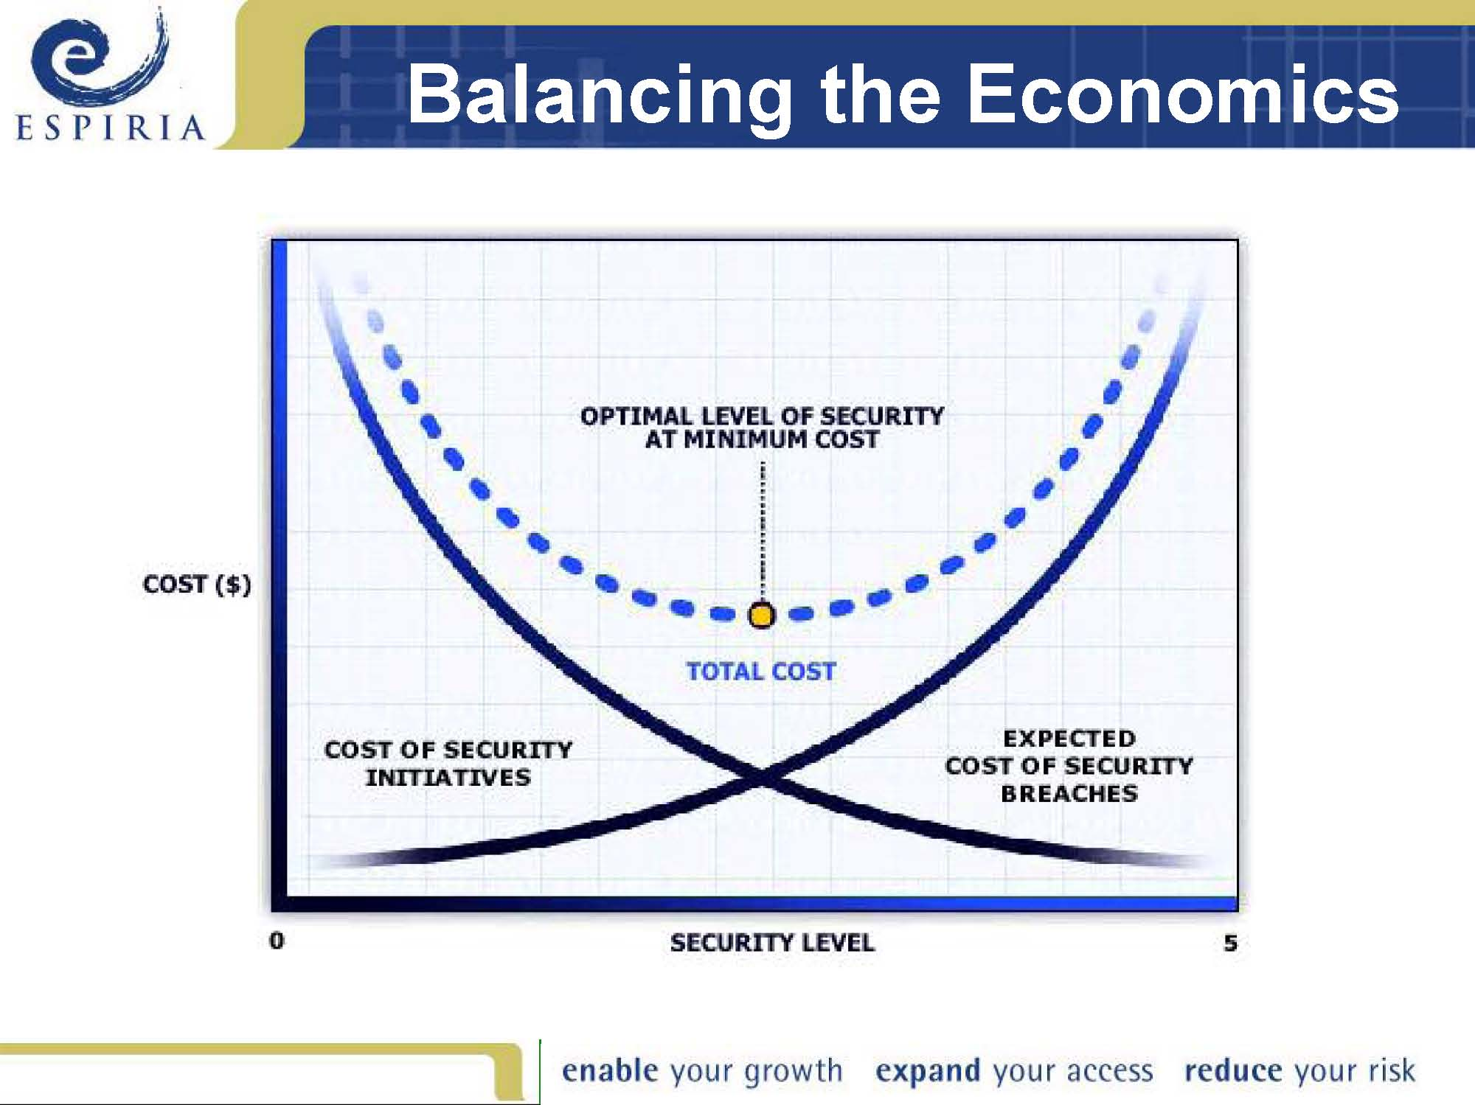
39

Slide 40
Reduce Risk
Evaluate alternatives, effectiveness, costs of countermeasures
Indicate where to most effectively use your limited resources
ROI Calculation
40

Slide 41
Risk Analysis Report Format
I. Introduction A. Reason for risk analysis study and its scope B. Description of physical facility C. Major security measures in use or being installed II. Background III. Requirements and Constraints A. Historical factors (previous risk analyses and results, serious security breaches, etc.) B. Time and manpower considerations; other constraints IV. Risk Analysis A. Published guidelines used B. Major threats considered and why C. Worksheets and summary D. Countermeasures (with costs) E. Cost/benefit analysis of each countermeasure/threat combination V. Recommendations (prioritized) VI. Summary
adapted from U. S. Dept. of Agriculture
41
Notes:
41
35
Prof. Lance J. Hoffman, The George Washington University
Risk analysis

Slide 42
Financial Institution - Risk Assessment
Threat
Likelihood
Impact
Controls
Testing of Controls – frequency, who
Effectiveness of Controls – results of testing
42

Slide 43
Security Risk Assessment
Security Element
OK
Review
Requires Immediate Attention
Physical Security
Is our computing equipment properly secured?
Account & Password Management
Do we ensure only authorized personnel have access to our computers?
Do we require and enforce appropriate passwords?
Virus Protection
Do we use, and regularly update, anti-virus software?
OK - the element has been addressed by department action or policy. All the detailed questions can be answered affirmatively.
Review - The basic issue has been addressed, but further review is warranted. Not all the detailed questions can be answered in the affirmative.
Requires Immediate Attention - The element has not been addressed or recently reviewed. Few, if any, of the detailed questions can be answered in the affirmative
43

Slide 44
Security Risk Assessment
Security Element
OK
Review
Requires Immediate Attention
Data Backup and Restoration
Do we periodically backup individual and department data?
Operating Systems
Are the operating systems we use updated with current security "patches"?
Application Software
Are our common applications configured for security?
OK - the element has been addressed by department action or policy. All the detailed questions can be answered affirmatively.
Review - The basic issue has been addressed, but further review is warranted. Not all the detailed questions can be answered in the affirmative.
Requires Immediate Attention - The element has not been addressed or recently reviewed. Few, if any, of the detailed questions can be answered in the affirmative
44

Slide 45
Security Risk Assessment
Security Element
OK
Review
Requires Immediate Attention
Confidentiality of Sensitive Data
Are we exercising our responsibility to protect sensitive data under our control?
Disaster Recovery
Do we have a current disaster recovery plan?
Security Awareness and Education
Are we providing information about computer security to our EMPLOYEES?
OK - the element has been addressed by department action or policy. All the detailed questions can be answered affirmatively.
Review - The basic issue has been addressed, but further review is warranted. Not all the detailed questions can be answered in the affirmative.
Requires Immediate Attention - The element has not been addressed or recently reviewed. Few, if any, of the detailed questions can be answered in the affirmative
45

Slide 46
Risk Assessment
Jacobson's Window
Consequences
Low
High
Don't care
"low-high"
Low
major fire
flooding
cash fraud
Occurrence Rate
Doesn't happen
power failure
High
software bug
key error
:high-low"
46
Notes:
46
26
Prof. Lance J. Hoffman, The George Washington University
Risk analysis

Slide 47
Mitigating High Single Occurrence Losses
Share the risk (insurance)
Disburse the risk (spread it around)
Reduce the vulnerability (e.g., implement an enhanced business resumption plan)
47
Notes:
47
18
Prof. Lance J. Hoffman, The George Washington University
Risk analysis

Slide 48
Recommendations
From the Risk Analysis, consider:
greatest risk
largest potential loss
loss of greatest frequency
Identify controls
Comment on status of existing controls
which to maintain
which to enhance
48

Slide 49
Benefits of Risk Analysis
Improved awareness by users and management
Documentation of assets and their vulnerabilities and possible controls
Provides an accountable basis for decision making
Provides accountable justification for expenditure on countermeasures
49

